Slide 2
Metagenomic analysis
Mikael Lenz Strube (milst@dtu.dk)

Slide 3
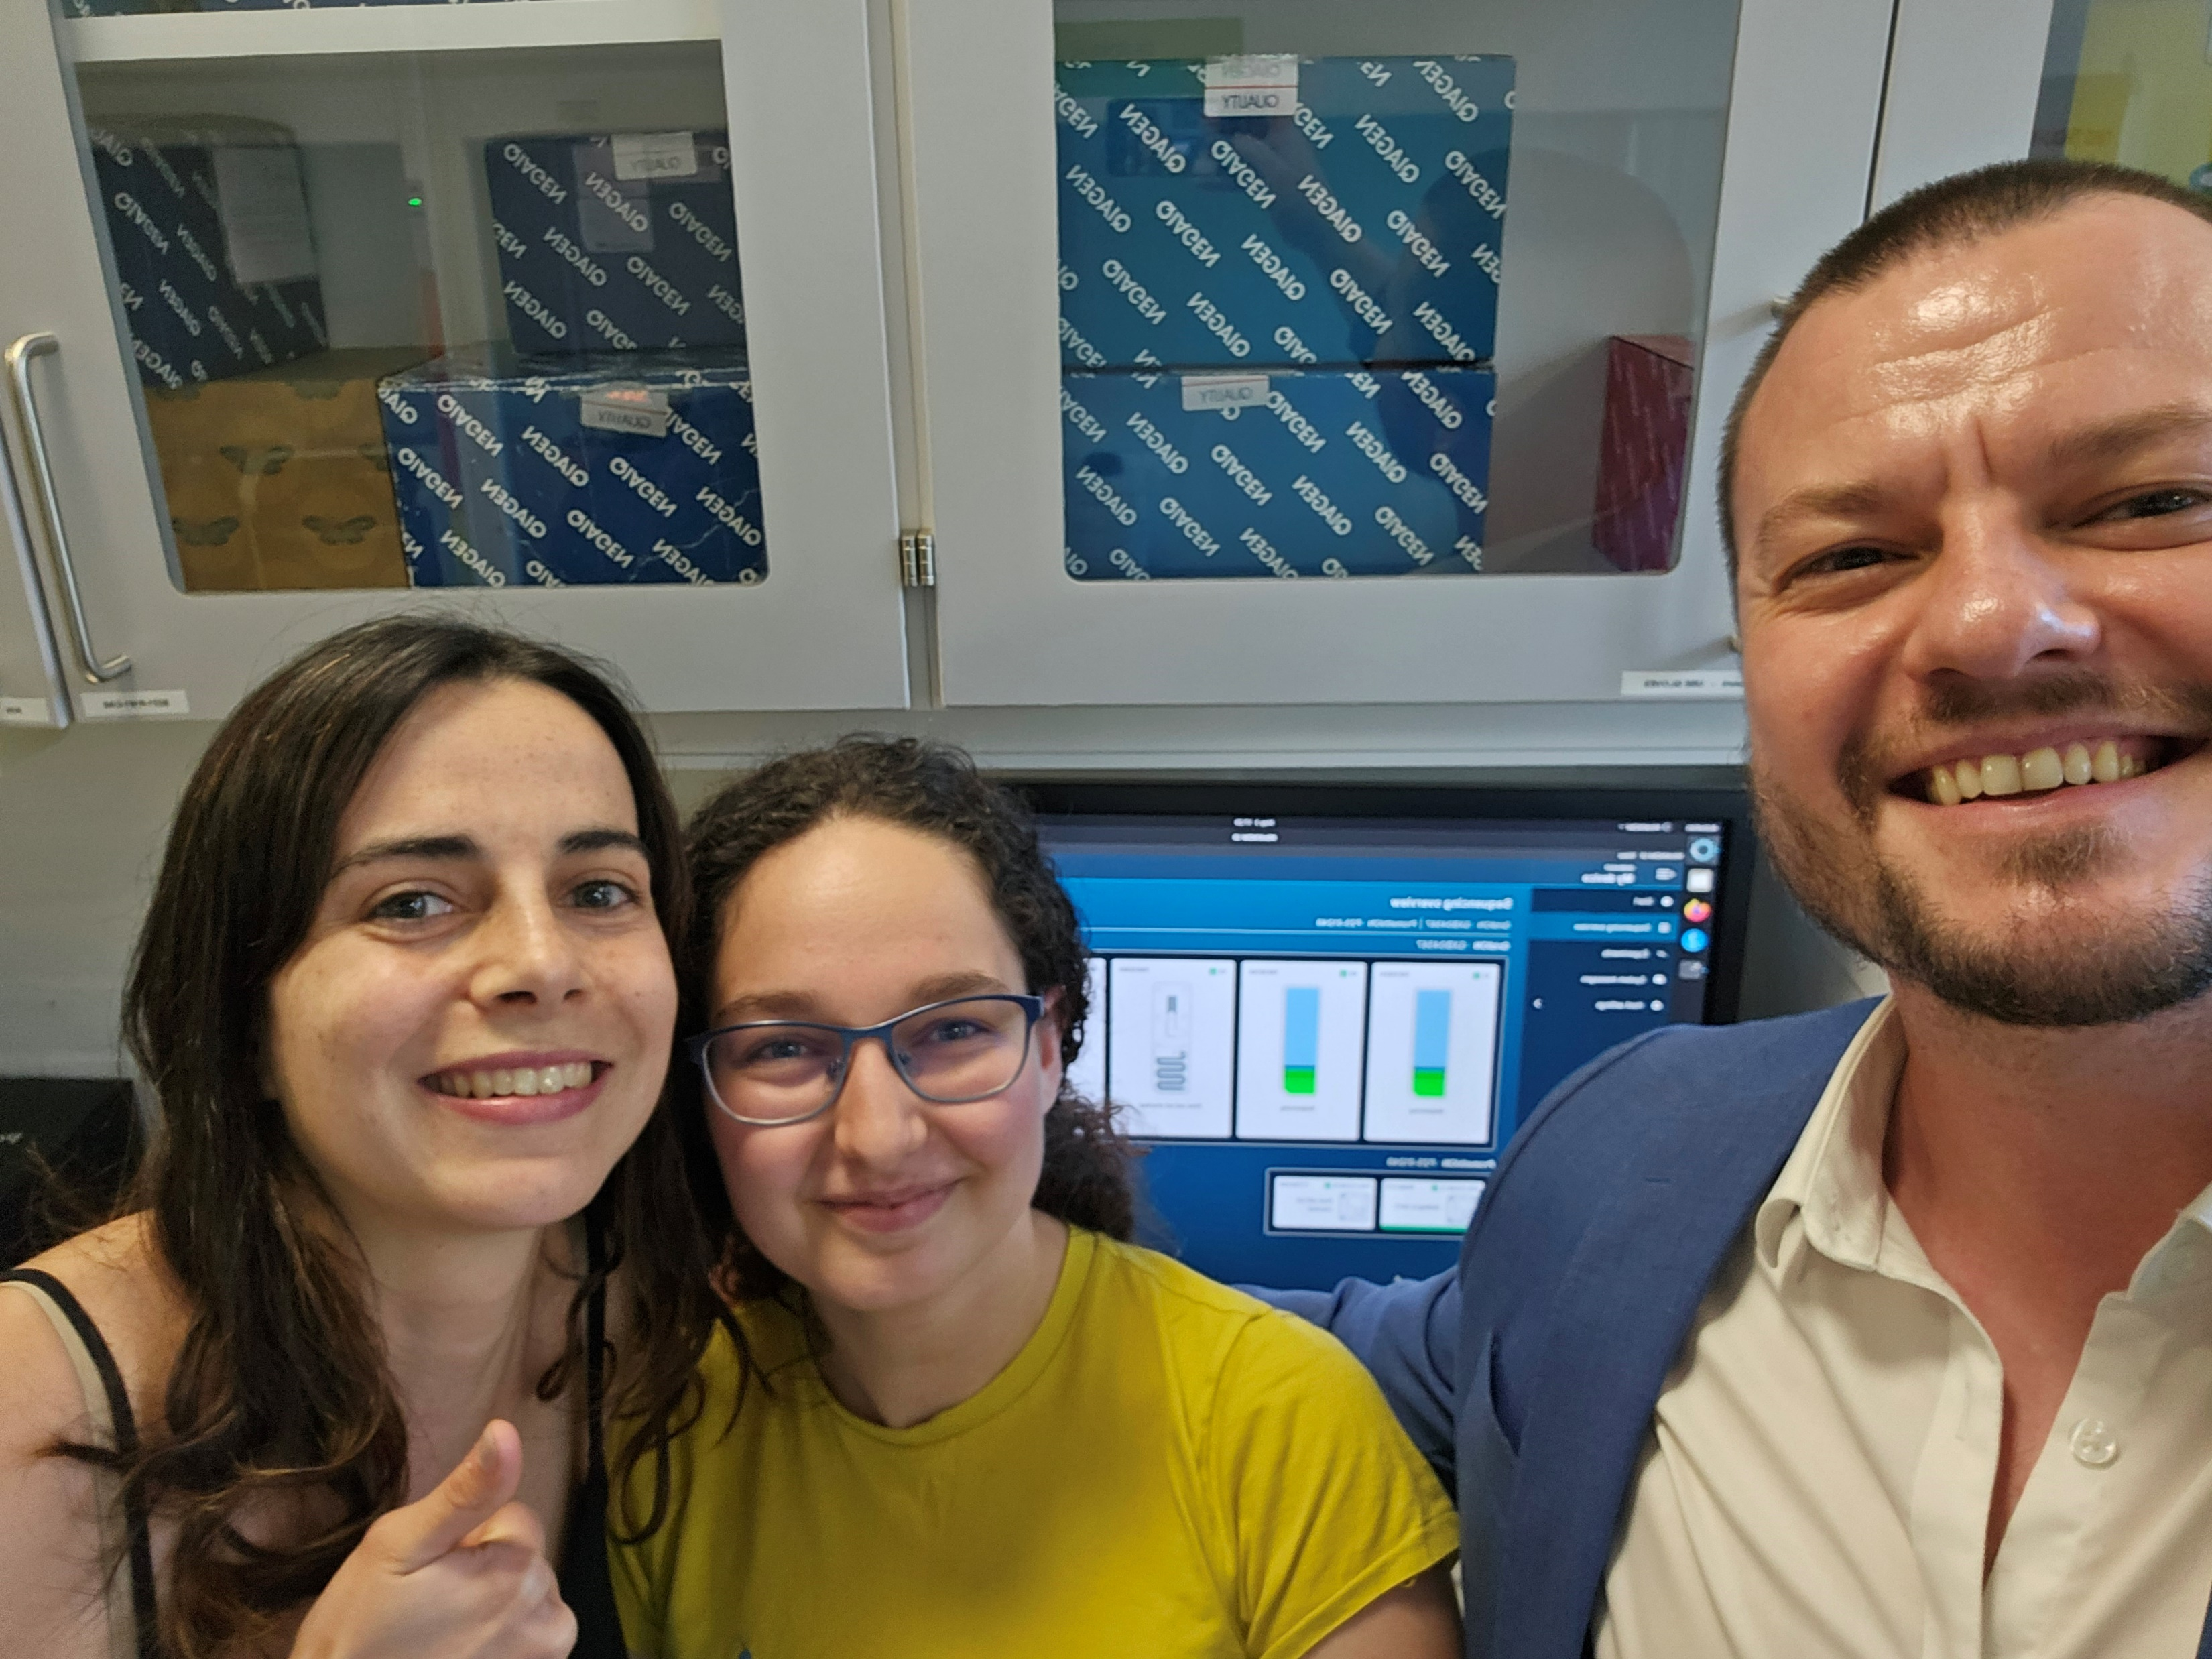

Slide 4
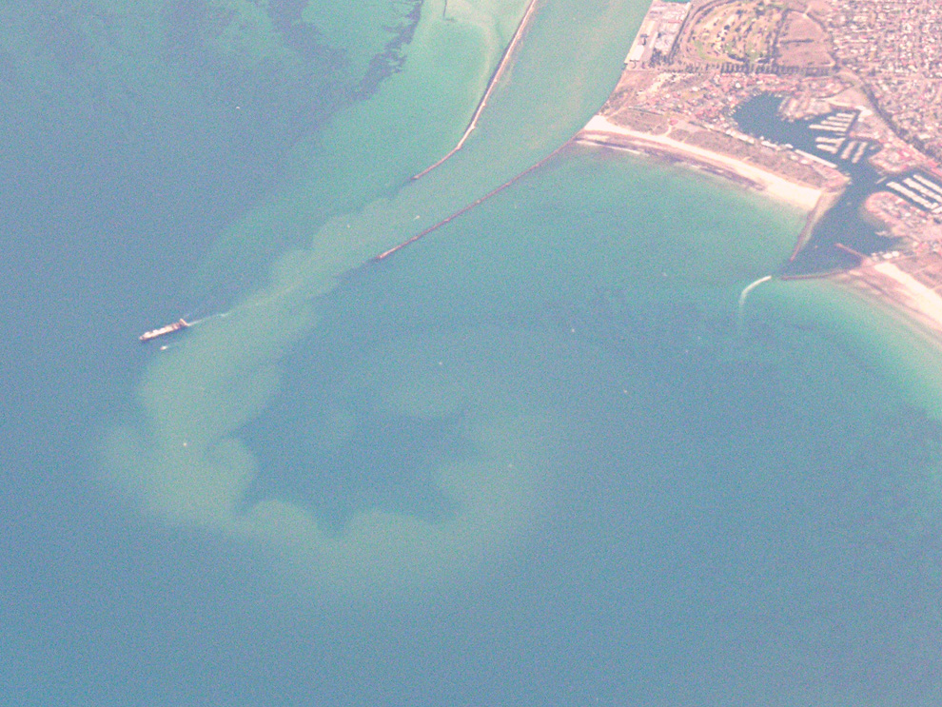
Marine sediments are full of novel BGCs

Slide 5
Short read sequencing cannot assemble BGCs

Slide 6
But long read sequencing can!

Slide 7
Bacterial genomes and how to sequence them
Fragment to short reads
Library prep
Purify
Sequence
(Illumina)
Assemble
contigs
Sequence
(Nanopore)
Hybrid
Assemble
Fragment to long reads
Library prep
complete
genome

Slide 12
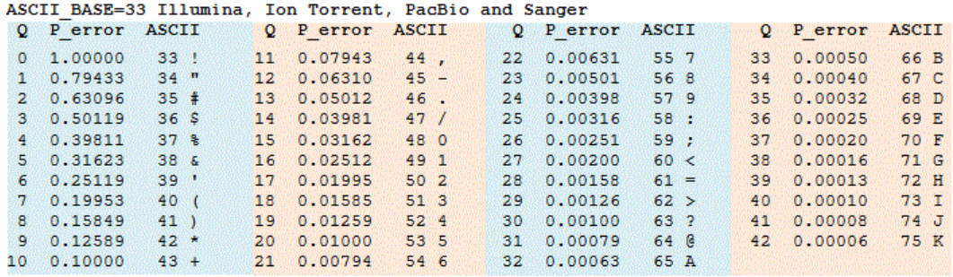

The .fastq file
@bf3d5b3c-c0f7-4b47-822e-e38e4b9041ef TTATGTCCTGTACTTCGTTGGTTGTGAAACCGATATTAACCAAGAAA…GCAGCAGCATGCTACGC + $%&&''$$$&)&&&'%%&''***+,)('&$%%%%%%%#$$$$$$$’3…SGSKSHKGKJFDEEFDK
$$P={10}^{{−Q}/{10}}$$

Slide 13

Sequencing parameters
How many sequences?
How many bases?
Average length?
Maximum length?
$Depth=\frac{Total bp}{Genome bp}=\frac{\text{328,448,899 }}{6,000,000}$ = 54.7
6,000,000
# sequences | Total bases | Shortest | Mean | Longest
36,000 | 328,448,899 | 78 | 9,123 | 89,609

Slide 14

Sequencing parameters
How many sequences?
How many bases?
Average length?
Maximum length?
$Depth=\frac{Total bp}{Genome bp}=\frac{\text{20,269,276,398}}{6,000,000}$ = 3378.2
6,000,000
# sequences | Total bases | Shortest | Mean | Longest
5,834,895 | 20,269,276,398 | 30 | 3,473.80 | 274,651

Slide 15
Filtering
> 1000bp
Adaptors

Slide 16
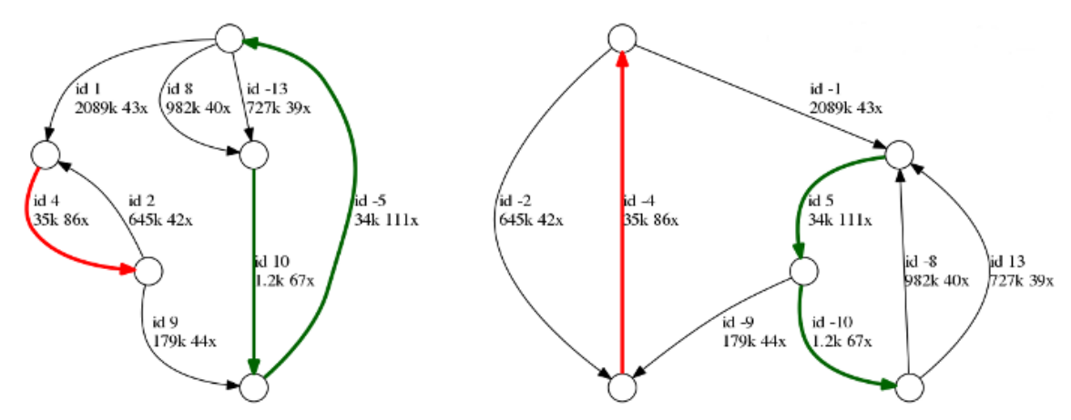
Assemble your sequences
Flye

Slide 17
Nanopore sequencing
Mikael Lenz Strube (milst@dtu.dk)

